Slide 1
Marketing and Retail Analytics

Slide 2
Contents of Presentation
Problem Statement
About Data
We are presented with the sales data of 3 years from the automobile parts manufacturer in form of the excel file.
Data Dictionary
Exploratory Data Analysis:
Product lines
Country wise Sales
Unit Price
Orders per Deal size
Order per categories
Sales per Customer
RFM Analysis
Customer Behaviour
Best Customer
List of Best Customers:
Workflow of Best Customer in KNIME
Customers on the Verge of Churning
Workflow of the Churning Out Customer
Lost Customers
Workflow of Lost Customers
Loyal Customers
Workflow of Loyal Customer
Tableau Best and Lost Customers Graphs
Tableau Link

Slide 3
Problem Statement
This project aims to find the underlying buying patterns of the customers of an automobile part manufacturer based on the past 3 years of the Company's transaction data and hence recommend customized marketing strategies for different segments of customers.

Slide 4
About Data
We are presented with the sales data of 3 years from the automobile parts manufacturer in form of the excel file.
The excel file consists of 2747 rows and 20 columns of data
The Data File Consists of
Customers Name
Product category
Order quantity
Order line
Order date
Etc..

Slide 5
Data Dictionary
Data | Data Meaning
ORDERNUMBER | Order Number | CUSTOMERNAME | customer
QUANTITYORDERED | Quantity ordered | PHONE | Phone of the customer
PRICEEACH | Price of Each item | ADDRESSLINE1 | Address of customer
ORDERLINENUMBER | order line | CITY | City of customer
SALES | Sales amount | POSTALCODE | Postal Code of customer
ORDERDATE | Order Date | COUNTRY | Country customer
DAYS_SINCE_LASTORDER | Days Since Lastorder | CONTACTLASTNAME | Contact person customer
STATUS | Status of order | CONTACTFIRSTNAME | Contact person customer
PRODUCTLINE | Product line – CATEGORY | DEALSIZE | Size of the deal based on Quantity and Item Price
MSRP | Manufacturer's Suggested Retail Price | PRODUCTCODE | Code of Product

Slide 6
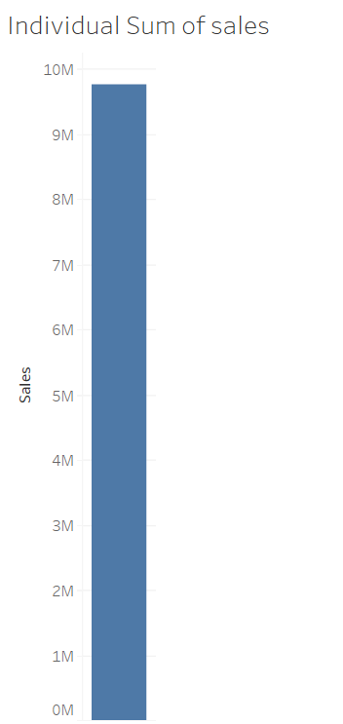
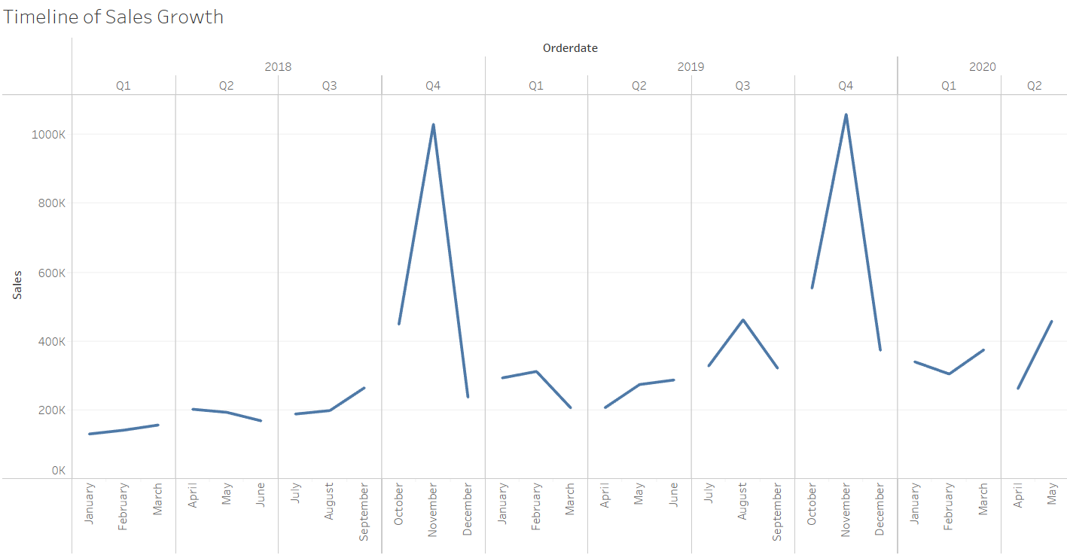
Exploratory Data Analysis:
There are total of 9,760,222 (9.7 Million) Sales revenue generated by the company in total
From the past 3 years of data, It is clearly visible that the Sales drastically tends to increase from the October to November.

Slide 7
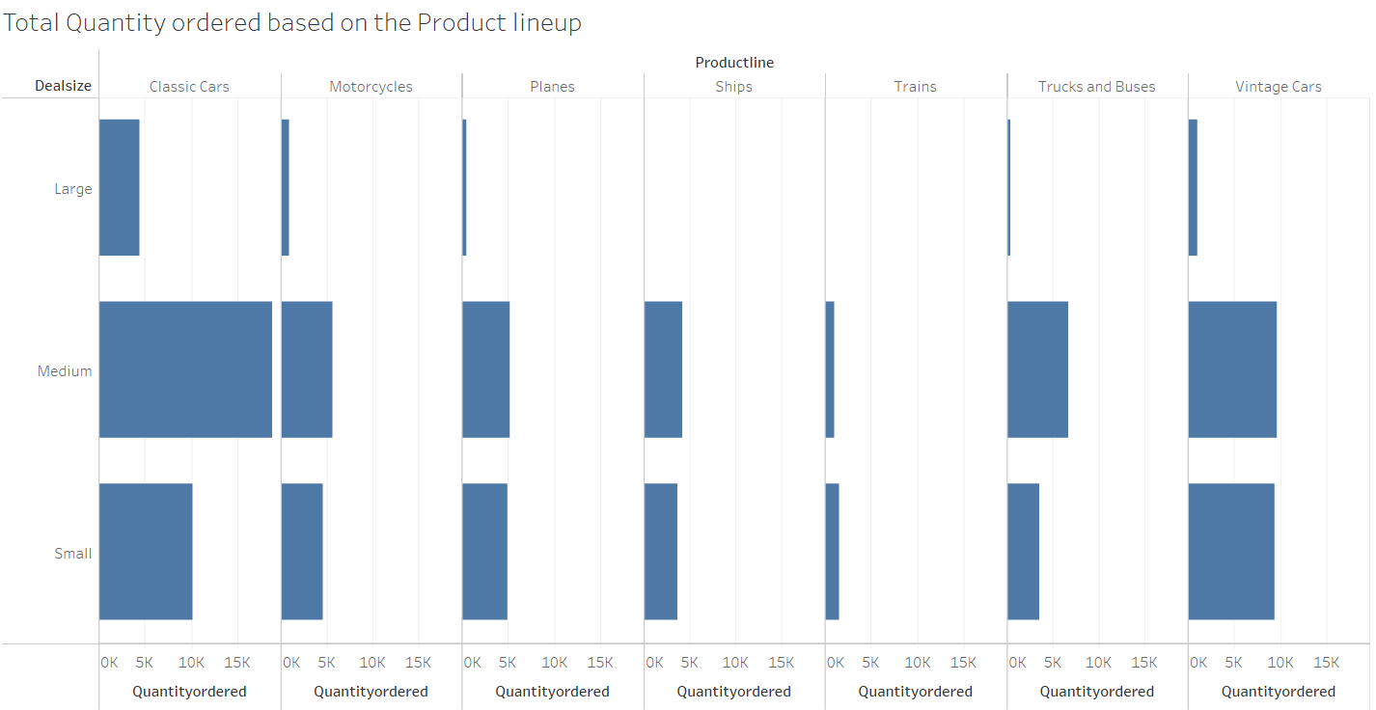
Product lines
There are quite a few types of product lines categories we manufactures
Classic car
Motorcycles
Planes
Ships
Trains
Trucks and Buses
Vintage Cars
There are Some Deal Sizes based upon on the order quantity by customer
Large
Medium
Small
Most Pre dominant Categories that is chose by our customer is
Classic car
Vintage cars
The Most Quantity received by us are from the Medium Deal sizes from Classic and vintage cars.

Slide 8
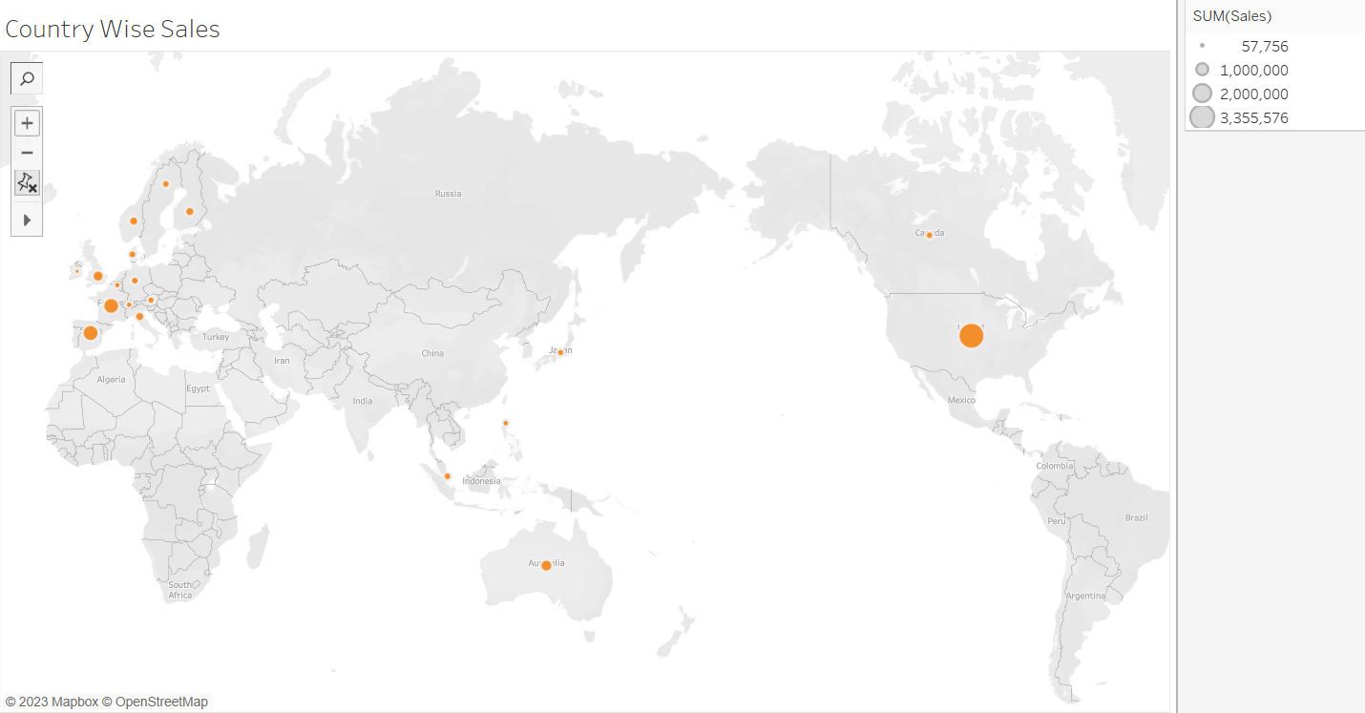
Country wise Sales
Our Customers generally come from different countries
The top 3 Countries from which our sales are higher as follows:
United States of America
Spain
France

Slide 9
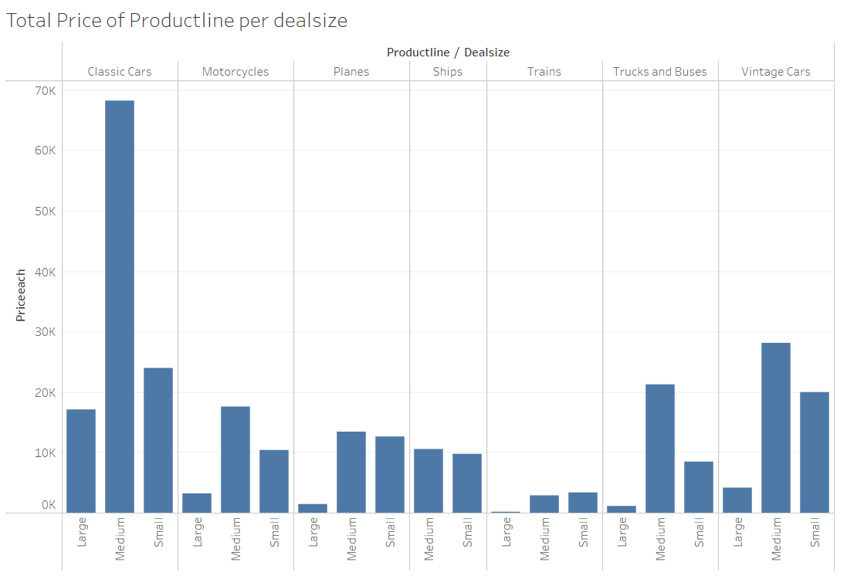
Unit Price
There are specific price for each and every unit of the product.
This is called Unit price.
The Image here shows that the sum of the price each with respect to the Product line. This has been sub classified into the deal size of the particular category.
The Sum of price of classic car in the medium deal size is higher.
The Sum of price of trains in the large deal size is the lowest.

Slide 10
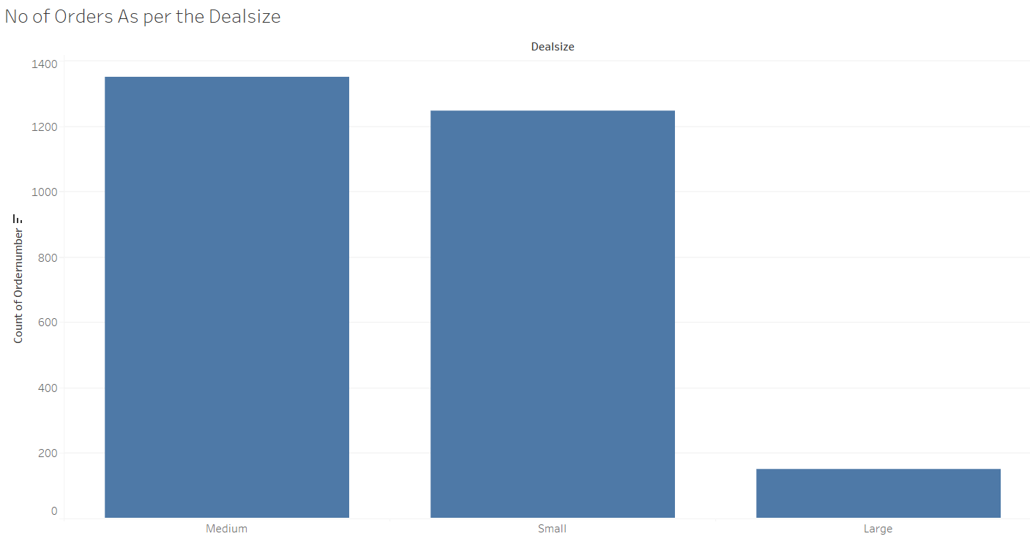
Orders per Deal size
The Number of orders in the Medium deal is the highest.
The Number of orders in the Large deal is Lowest.

Slide 11
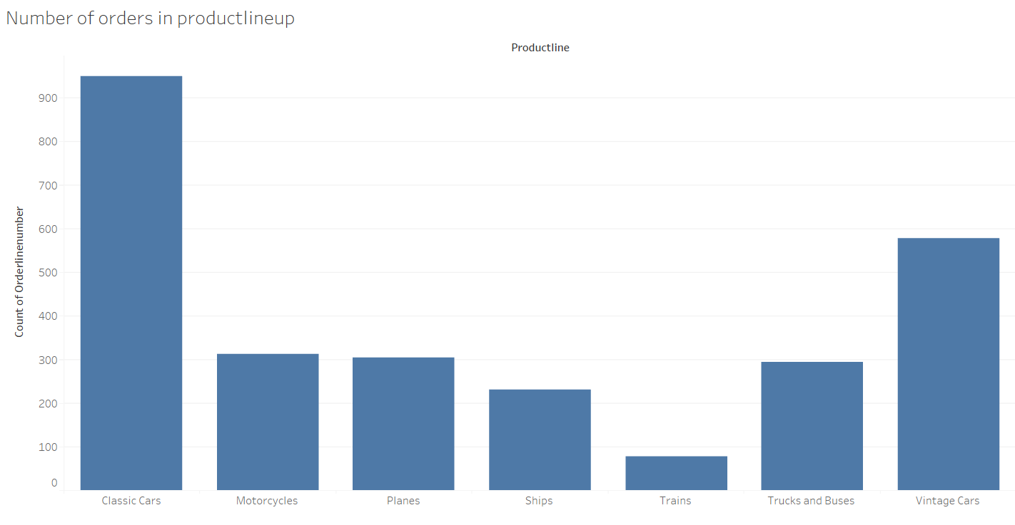
Order per categories
The Below is the list of the categories that has the orders from higher to the lowest
Classic cars - 949
Vintage Cars- 579
Motorcycles - 313
Planes – 304
Trucks and Buses - 295
Ships - 230
Trains - 77

Slide 12
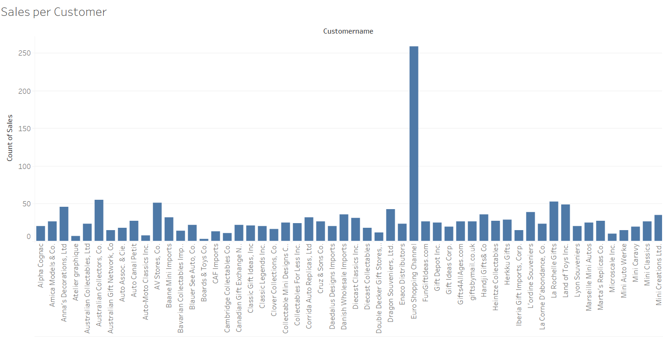
Sales per Customer
The Image shows the list of customers with respect to their count of the Sales.
This also shows that the Customer with the highest count of sales has purchased more products from our company in comparison to the other customer.

Slide 13
RFM Analysis
RFM Analysis is nothing but
Recency
Frequency
Monetary
These 3 Key Parameter plays a major role in identifying the buying patterns of the customer.
With these Buying Pattern we can come to conclusion on which area and what are improvements needed to be made to boost up the Sales and increase profit margin.
This also identifies Customer Behaviour through which we can take the major decisions from sales point of perspective.

Slide 14
Customer Behaviour
From the RFM Analysis we will segregate the Recency , Frequency and monetary into 3 sub parameters such as follows:
High – Group who buys often, spends more and visited the manufacturer recently.
Medium – Group which spends less than high group and is not that much frequent to visit Manufacturer.
Low – Group which is on the Verge of Churning out.

Slide 15
Best Customer
From the Given data, We can identify the Best Customer by using RFM Analysis
RFM Analysis can be in Multiple tools such as:
Excel
KNIME
Python
Here I am utilising the KNIME for the purpose of Identifying RFM Analysis.
Best Customer are the ones who Spend More on our Brand. That is the highest Monetary Value of the customer.

Slide 16
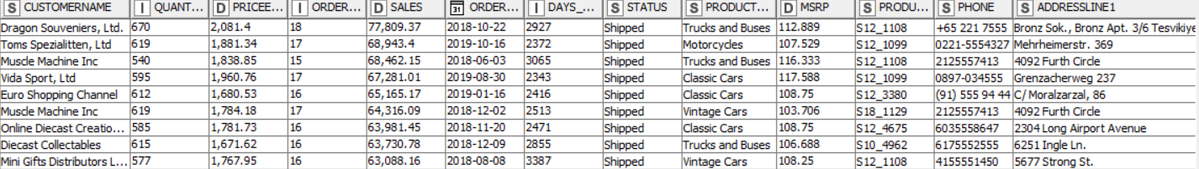
List of Best Customers:
Dragon Souveniers, ltd
Toms Spezialitten, ltd
Muscle Machine Inc
Vida Sport, Ltd
Euro Shopping Channel
Online Diecast Creations Co.
The KINME Inference Image is attached.

Slide 17
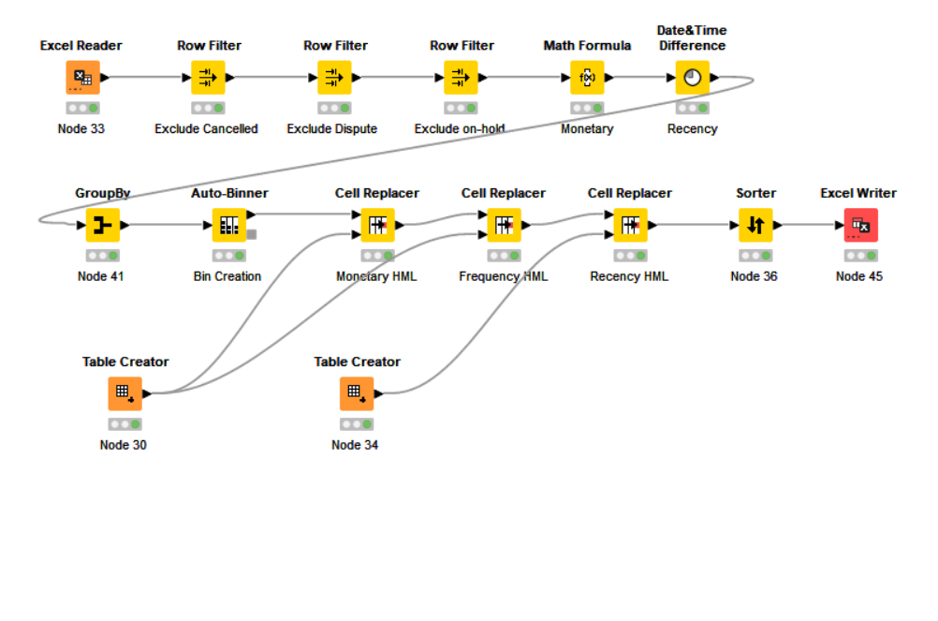
Workflow of Best Customer in KNIME

Slide 18
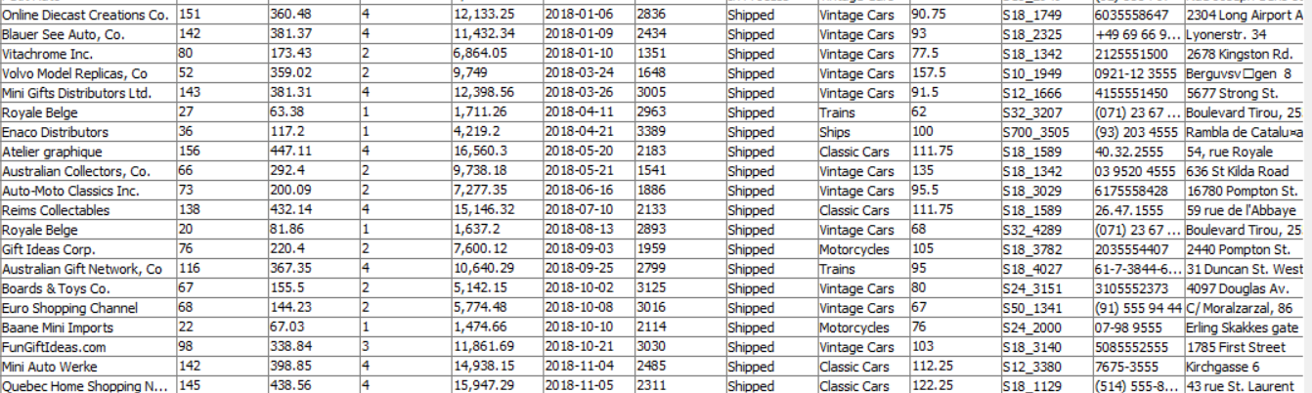
Customers on the Verge of Churning
The Customer Who have Low Recency, Low Frequency, and Low Monetary are the Customer on the verge of churning out.
The List of Customers on the verge of Churning out are as follows
Blauer See Auto, Co.
Vitachrome Inc.
Volvo Model Replicas, Co.
Mini Gifts Distributors Ltd.
Royal Belge
Enaco Distributors
Atelier graphique.

Slide 19
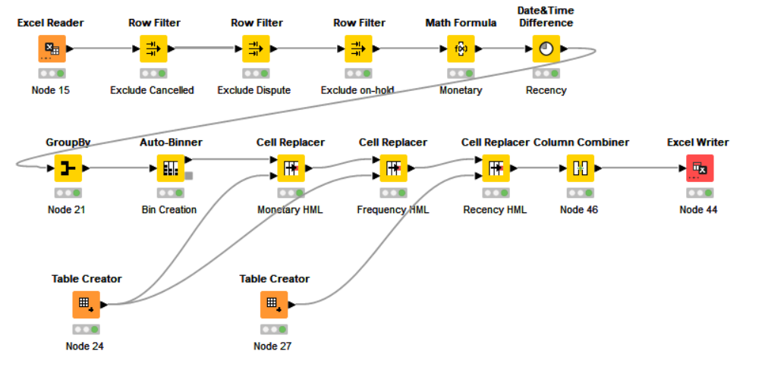
Workflow of the Churning Out Customer

Slide 20
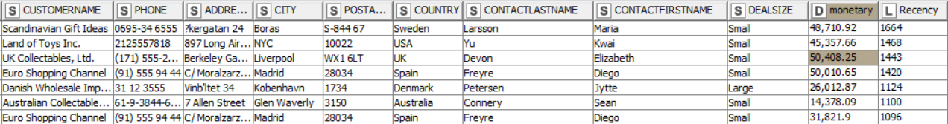
Lost Customers
The Lost Customers are the ones who have cancelled their order and have a dispute with the vendor of the product.
The List of Lost Customer are as follows:
Scandinavian Gift Ideas
Land of Toys Inc.
UK Collectables, Ltd.
Danish Wholesale Imports
Australian Collectables, Ltd.

Slide 21
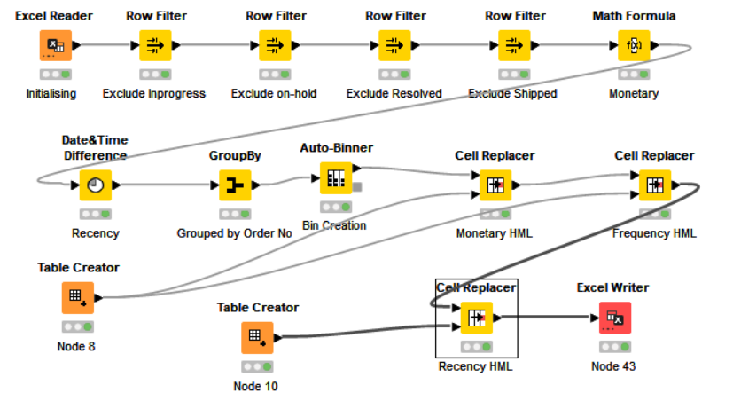
Workflow of Lost Customers

Slide 22
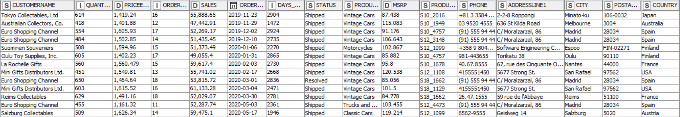
Loyal Customers
The Loyal Customers are group of customers who buys often, with more monetary value, Visits recently.
The List of Loyal Customers are as follows:
Tokyo Collectables, Ltd
Euro Shopping Channel
Suominen Souveniers
Oulu Toy Supplies, Inc.
La Rochelle Gifts
Reims Collectables
Slazburg Collectables

Slide 23
Workflow of Loyal Customer

Slide 24
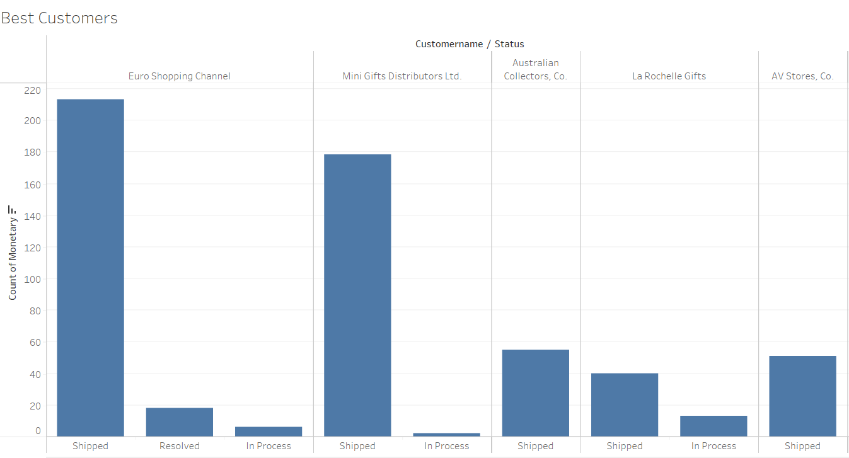
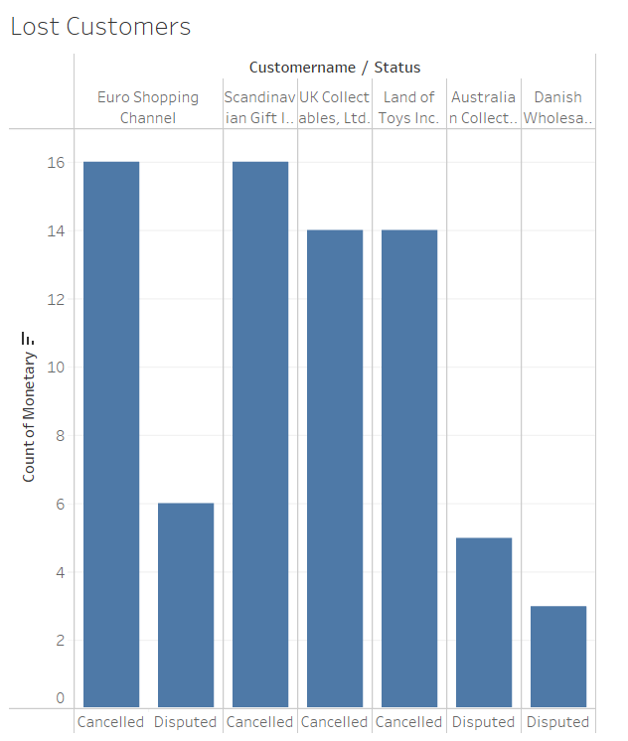
Tableau Best and Lost Customers Graphs

Slide 25
Tableau Link
https://public.tableau.com/app/profile/anand.ramaswamy/viz/Sales_Data_RFM_analysis/CountrySales?publish=yes

